Slide 1
Presentation on Microcontroller(AVR) & Microcontroller Assembly
By Group-3 (2003021-2003030)
2003021-MD BASARATUL FERDAUS
2003022-ΑΝΙΚΑ MAHBUBA
2003023-MD RASHEDUL ISLAM
2003024-MD AL-ZAMI ASHRAF
2003025-MAISHA FARZANA
2003026-FARZANA HAIDER
2003027-TONΜΟΥ
2003028-MD ABDULLAH AL MAMUN
2003029-MD. SHAJU HOSSAIN
2003030-TANJIM MOHAMMAD MUBARRAT

Slide 2
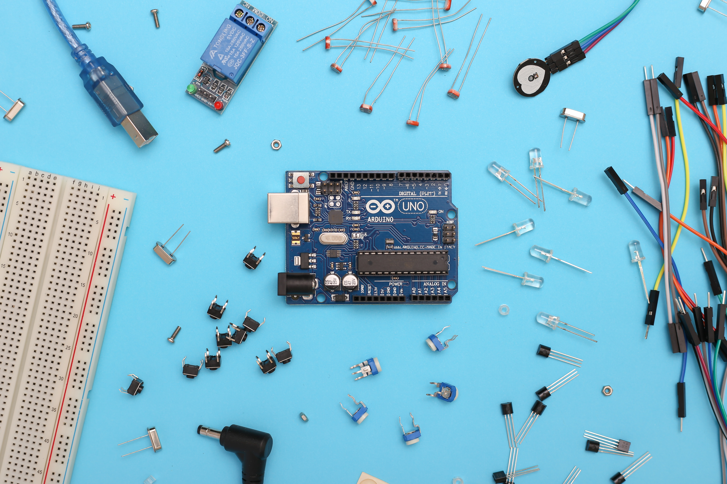

The AVR Microcontrollers:
History and Features
Prepared by 2003021-MD BASARATUL FERDAUS

Slide 3
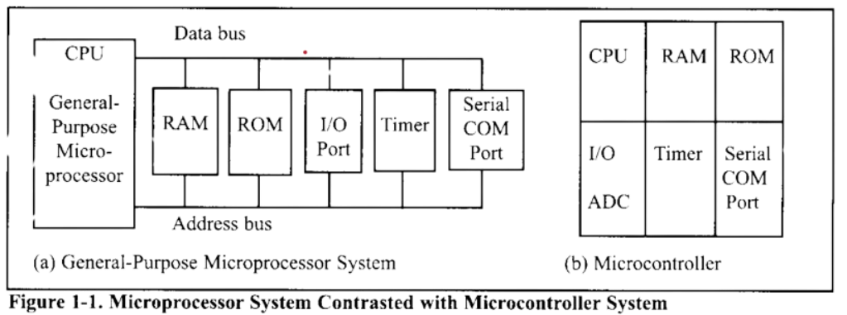
Microcontrollers vs general purpose Microprocessors
General purpose microprocessors doesn’t have in built RAM,ROM or I/O ports. The designer needs to add them additionally to make them functional. On the other hand , Microcontrollers have these things in built so its more specifically usable.
Choosing a Microcontroller
There are 5 major Microcontrollers:
1 -> 68HC08/68HC11 by Motorolla
2 -> Intel’s 8051
3 -> Atmel’s AVR
4 -> Zilog’s Z8
5 -> PIC from Microchip Technology
3 Criteria in choosing Microcontrollers are:
1 => Meeting the computing needs
2 => Availability of tools such as Compilers
3 => Wide availability and reliability

Slide 4



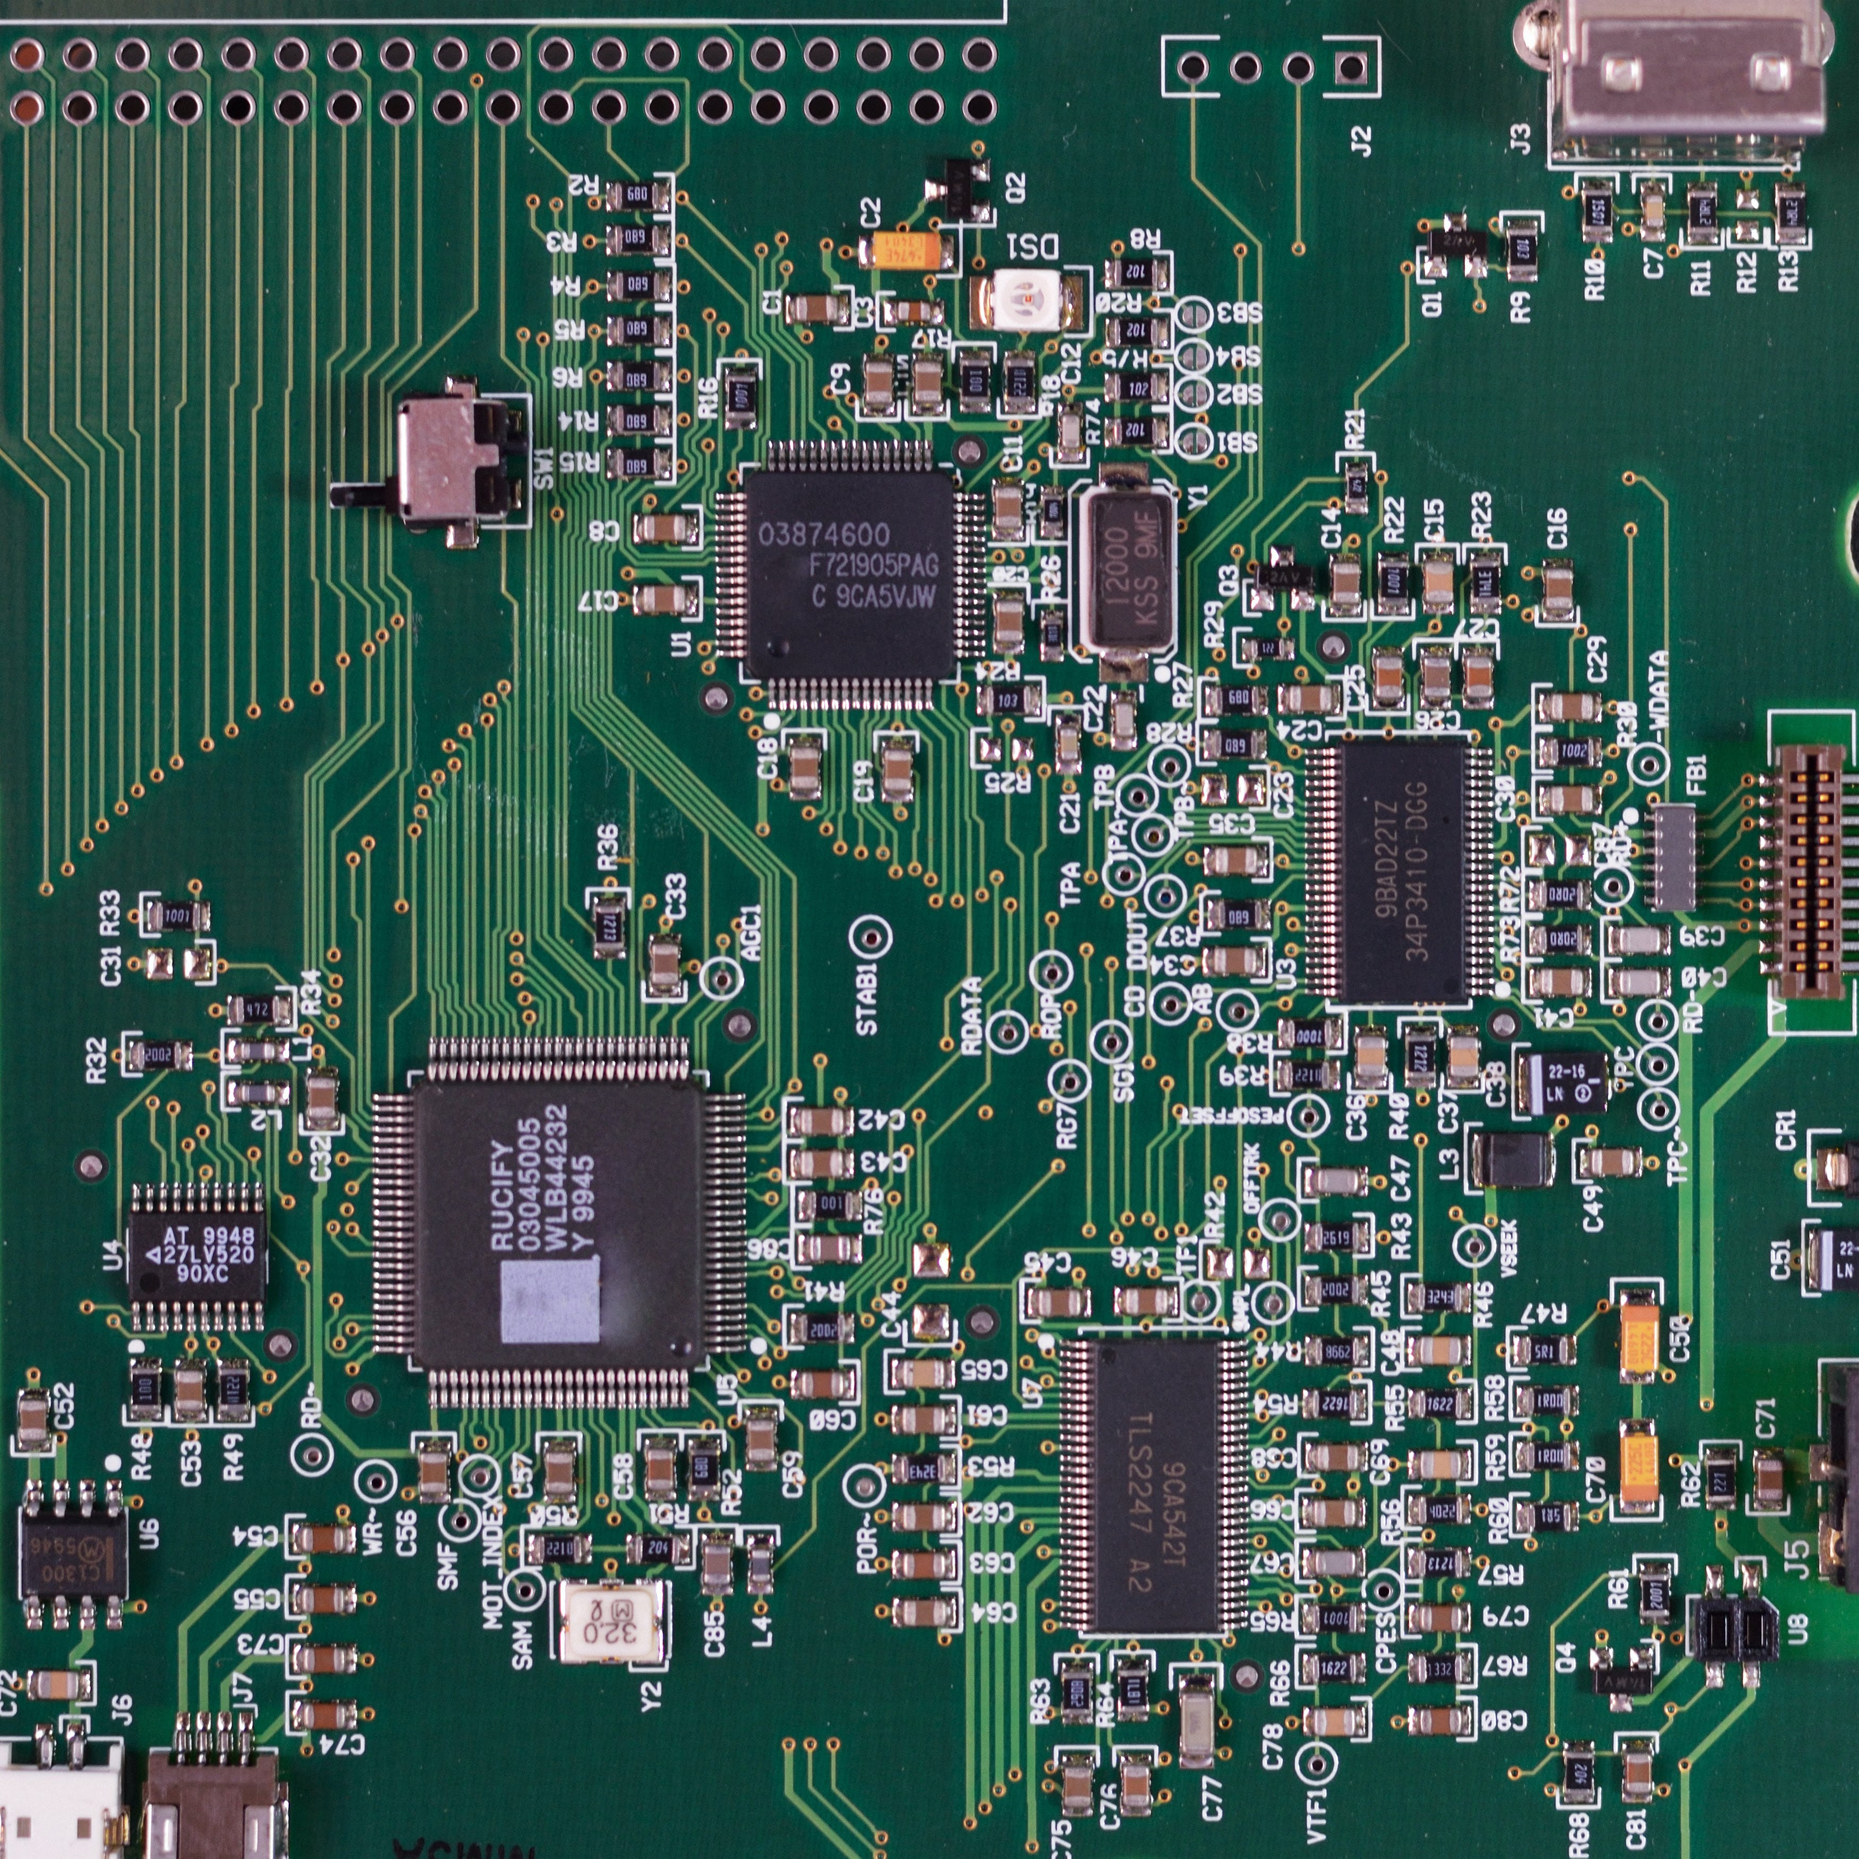
History of the AVR Microcontroller
The basic architecture was built by two students of NTH Alf & Vegard then bought and developed by Atmel in 1996. AVR stands for Alf-Vegard RISC (Reduced Instruction Set Computer)
Generally Classified in 4 groups
*Mega , Tiny , Special Purpose & Classic
AVR Features:
8 bit RISC single chip Microcontroller
Inbuilt ROM,RAM,EEPROM,timers,I/O ports
ADC,PWM,USB and so on

Slide 5
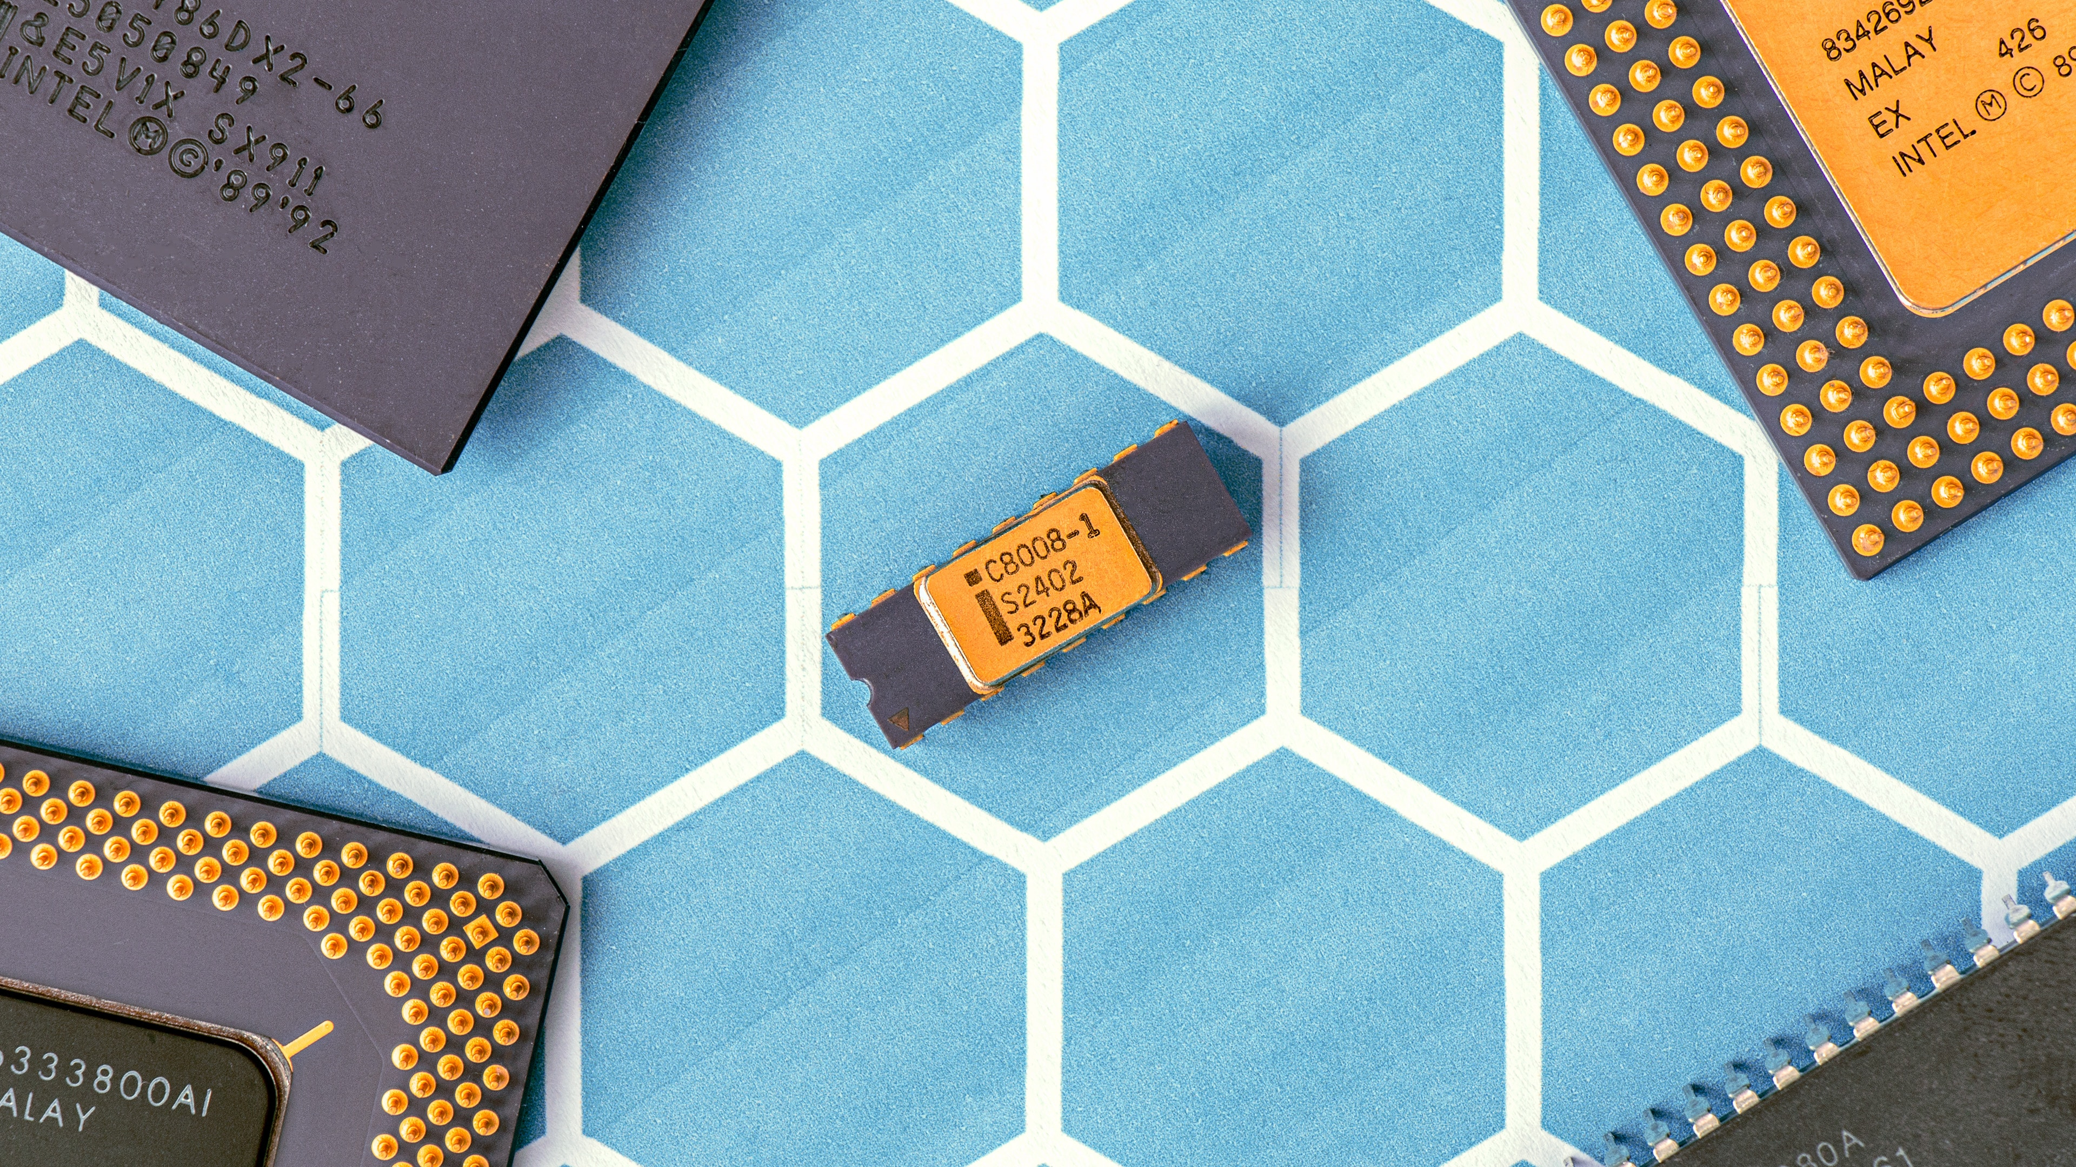
AVR Microcontroller Program ROM:
Has 8MB program code ROM space but can vary model to model. It is also the first microcontrollers to use on-chip Flash memory for program memory. It’s ideal for fast development cause it can be erased in seconds compared to 20 minutes or more needed by UV-EPROM
AVR Microcontroller data RAM & EEPROM:
RAM is for data storage.AVR has a maximum 64kb of data RAM storage.It has 3 components:
General-purpose registers [ 32 ]
I/O memory [ varies from chip to chip ]
Internal SRAM [ varies from chip to chip ]
AVR Microcontroller I/O Pins:
It can have 3 to 86 pins for I/O. Total number of pins for the AVR package goes from 8 to 100.
8 pin AT90S2323 has 3 pins for I/O
100 pin ATmega1280 has 86 pins for I/O
Peripherals: Most of the AVRs come with ADC (Analog to Digital Converter),Timers,USART(Universal Synchronous Asynchronous Receiver Transmitter)

Slide 6


AVR family overview:
Classic >> This is original AVR chip later replaced by the new ones. Example: AT90S2313,AT90S2323 etc.
Mega >> These are powerful and have more than 120 instructions, lots of different peripherals. Example: ATmega8, ATmega16, ATmega32, ATmega64, ATmega1280 etc.
Tiny >> As named it has less instructions , less peripherals compared to Mega. Example: ATtiny13,ATtiny25,ATtiny44 etc.
Special Purpose >> IC’s of this group can be considered as subset of other groups.Yet they have special capabilities like : USB controller,CAN controller,LCD controller etc. Example: AT90CAN128,AT90USB1287 etc.
Other Microcontrollers: There are other Microcontrollers made by Atmel,Microchip,Intel,Zilog etc. For comprehensive treatment of them see “The 8051 Microcontroller & Embedded systems”,”PIC Microcontrollers & Embedded systems” by Mazidi.
Thank You

Slide 7
Topic 2. Microcontroller Architecture & General-Purpose Registers in Microcontroller
Presented By,
Farzana Haider
Roll:2003026
Section: A
CSE 20

Slide 8
AVR uses Harvard Architecture.
There are separate buses for the separated code and the data memory.
The Program Bus provides access to the Program Flash ROM whereas the Data Bus brings data to the CPU.
This allows the AVR microcontroller to fetch instructions and data simultaneously, improving efficiency and performance in certain applications.

Slide 9
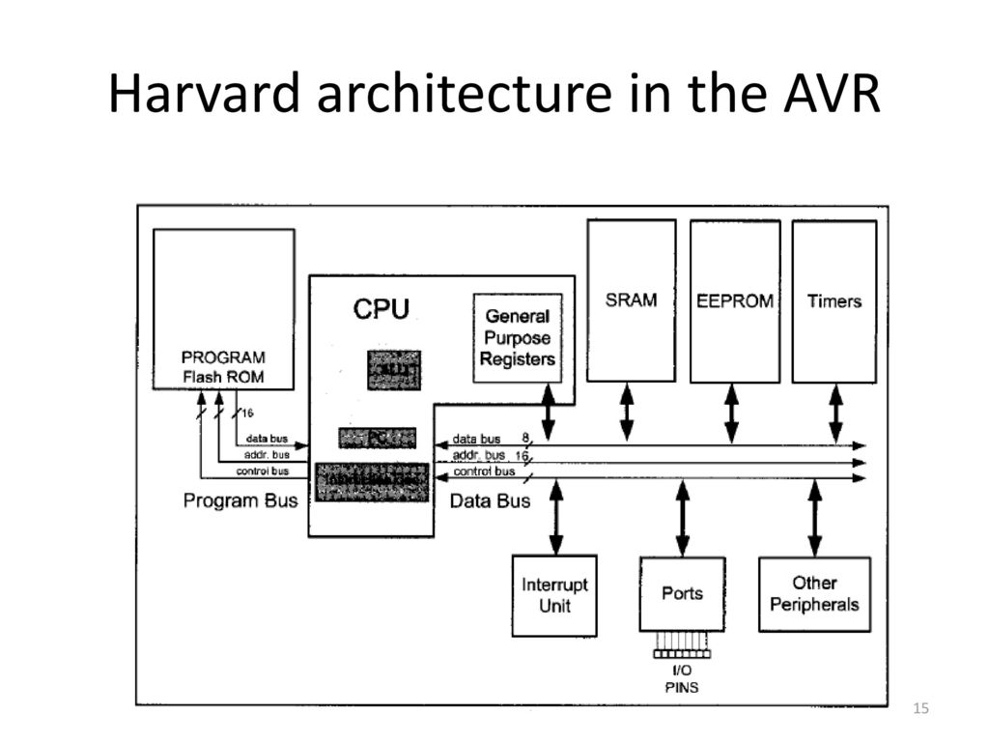
ALU
PC
Instruction Decoder

Slide 10
The General Purpose registers
In the CPU, registers are used to store information temporarily.
That information could be a byte of data to be processed or an address pointing to the data to be fetched.
In AVR there are 32 general purpose registers. They are R0 to R31 and are located in the lowest location of a memory address. All of these are 8 bits.
The 8 bits of a register
They can be used by all arithmetic and logic instruction.
R0
R1
R2
.
.
R14
R15
R16
R17
R18
.
.
R30
R31
D7 D6 D5 D4 D3 D2 D1 D0
MSB
LSB

Slide 11
example
To understand the use of general purpose registers, we will show it in the context of two simple instructions: LDI and ADD
LDI instruction:
The LDI instruction copies 8-bit data into the general purpose registers.
LDI Rd, K ;load Rd (destination) with immediate value K
;d must be between 16 and 31
K is an 8-bit value that can be 0-255 in decimal or 00 to FF in hex and Rd is R16 to R31.
The following instruction loads the R20 register with the value 0x25 (25 in hex)
LDI R20, 0x25 ; R20 = 0x25

Slide 12
Add instruction:
The ADD instruction has the following formal:
ADD Rd, Rr ; Add Rr to Rd and store the result to Rd
The add instruction tells the CPU to add the value of Rr to Rd and put the result into the Rd register.
To add two numbers such as 0x25 and 0x34, one can do the following:
LDI R16, 0x25
LDI R17, 0x34
ADD R16,R17
Executing above line results in R16 = 0x59 (0x25 + 0x34 = 0x59)

Slide 13
3. Microcontroller Data Memory
There are two kinds of memory space in AVR microcontroller.
1.Code Memory Space 2.Data Memory Space
The Data memory is composed of three(3) Parts :
A.GPRs(general purpose register)
B.I/O memory
C. Internal Data SRAM
By 2003029-MD. SHAJU HOSSAIN

Slide 14
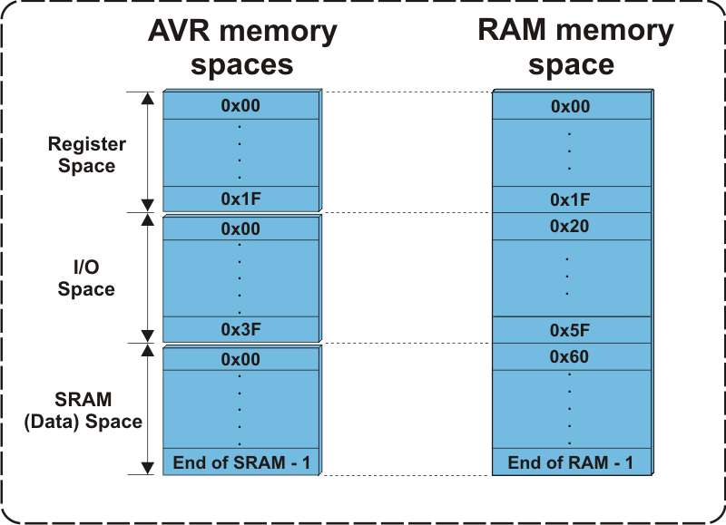
Figure : The Data Memory For AVRs

Slide 15
GPRs(general purpose register)
The GPRs use 32 bytes of Data Memory .
They always take the address location $00-$1F in the data memory space , regardless of the AVR chip number.
GPRs are an integral part of the CPU's register file, and they play a crucial role in executing instructions and performing arithmetic and logic operations.

Slide 16
I/O memory
1.The I/O memory is dedicated to spacfic functions such as register , timers, serial communication ,I/O ports, ADC and so on.
2.The AVR I/O memory is made of 8 bit registers.
3.The number of locations in the data memory set aside for I/O memory depends on the pin numbers .
4. ATmega64, ATmega128 and ATmega256 are the AVRS with more than 32 I/O pins.

Slide 17
Internal Data SRAM
SRAM stands for Static Random-Access Memory. It is a type of volatile semiconductor memory that stores data in a static form, meaning it doesn't need to be periodically refreshed like dynamic RAM (DRAM)
Internal data SRAM in widely used for storing data and parameters by AVR programmers and C compilers.
Each location of SRAM can be accessed directly by its address.
The size of SRAM can vary to vary from chip to chip.

Slide 18
USING INSTRUCTION WITH THE DATA MEMORY
LDS Instruction:
LDS R16, 0x0100
“LDS” is the instruction mnemonic
“R16” is the destination register pair.
“0x0100” is the 16 bit address from which the data will be loaded.
STS Instruction :
“STS” is the instruction mnemonic.
“0x0100” is the 16-bit address in data memory where the data will be stored.
“R16” is the source register containing the data to be stored.

Slide 19
4.AVR STATUS REGISTER
Presented by
Maisha Farzana
Roll: 2003025
Section: A

Slide 20
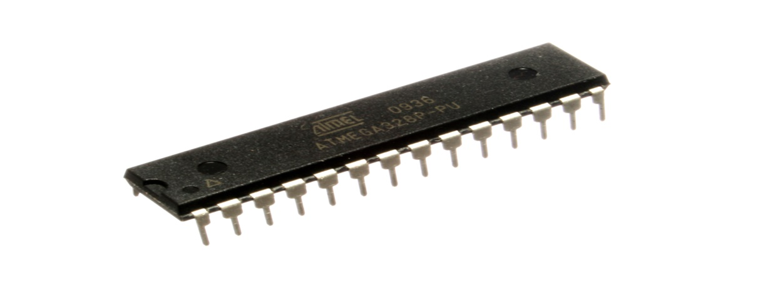
DECODING THE AVR STATUS REGISTER : Understanding the bits that influence the program flow
Fig: AVR Microcontroller Chip
The AVR Status Register(SREG) is an 8-bit register that stores status flags resulting from arithmetic and logical operations.
These flags play a crucial role in conditional branching and decision making within AVR programs.

Slide 21
SREG BIT LAYOUT
Bit
SREG
D7
D0
I | T | H | S | V | N | Z | C
C- Carry flag
Z- Zero flag
N- Negative flag
V- Overflow flag
S-Sign flag
H- Half carry
T- Bit copy storage
I- Global interrupt enable

Slide 22
SREG FLAGS
Carry flag:
Set if an arithmetic operation results in a carry or borrow.
Used for multi-byte operations shift/rotate instruction.
Zero flag:
Set if the result of an operation is zero.
Used for conditional branching and comparisons.
Negative flag:
Set if the result of an operation is negative.
Indicates the MSB(most significant bit) of the result.
Overflow flag:
Set if a signed arithmetic operation overflows.
Essential for detecting errors in signed calculations.

Slide 23
SREG FLAGS
Sign flag:
Set if N ⊕ V (exclusive OR of N and V)
Simplified way to check for negative results in signed operations
Half carry flag:
Set if a carry occurs from bit 3 to bit 4 in an arithmetic operation
Primarily used for BCD (Binary-Coded Decimal) arithmetic
Bit copy storage:
Used for bit-level operations with BLD (Bit Load) and BST (Bit Store) instructions
Not directly affected by most ALU operations
Global interrupt enable:
Enables or disables all interrupts globally
Set to enable interrupts, cleared to disable them

Slide 24
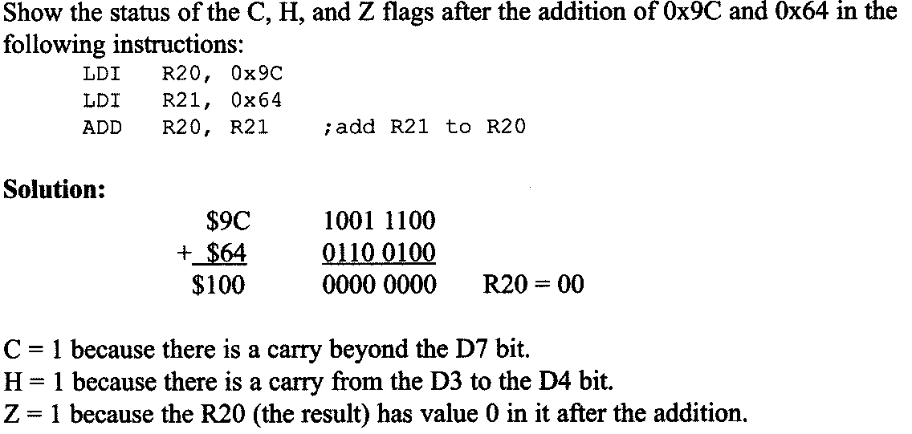
ADD INSTRUCTION AND STATUS REGISTER
Example:

Slide 25
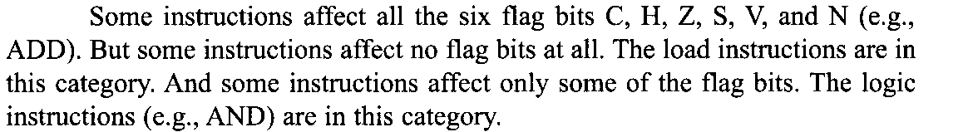
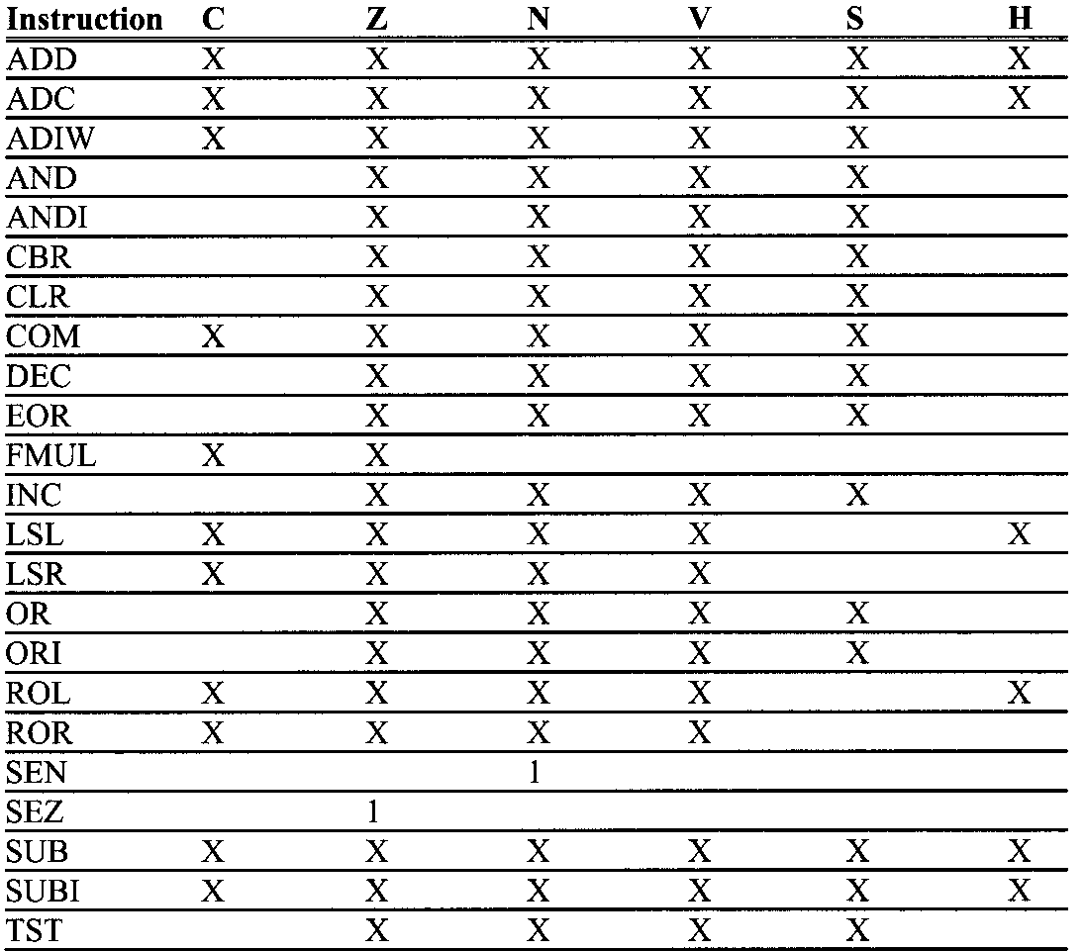
INSTRUCTIONS THAT AFFECT FLAG BITS
Here, X can be 0 or 1

Slide 26
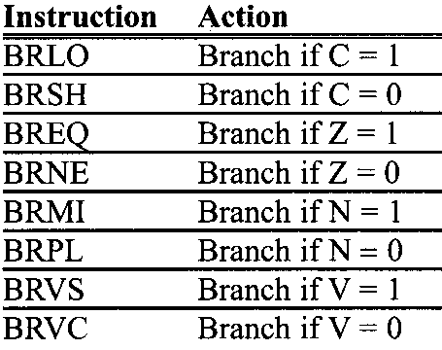
FLAG BITS AND DECISION MAKING
There are instructions that will make a conditional jump(branch)
based on the status of the flag bits.
AVR branch(jump) instructions using flag bits:

Slide 27
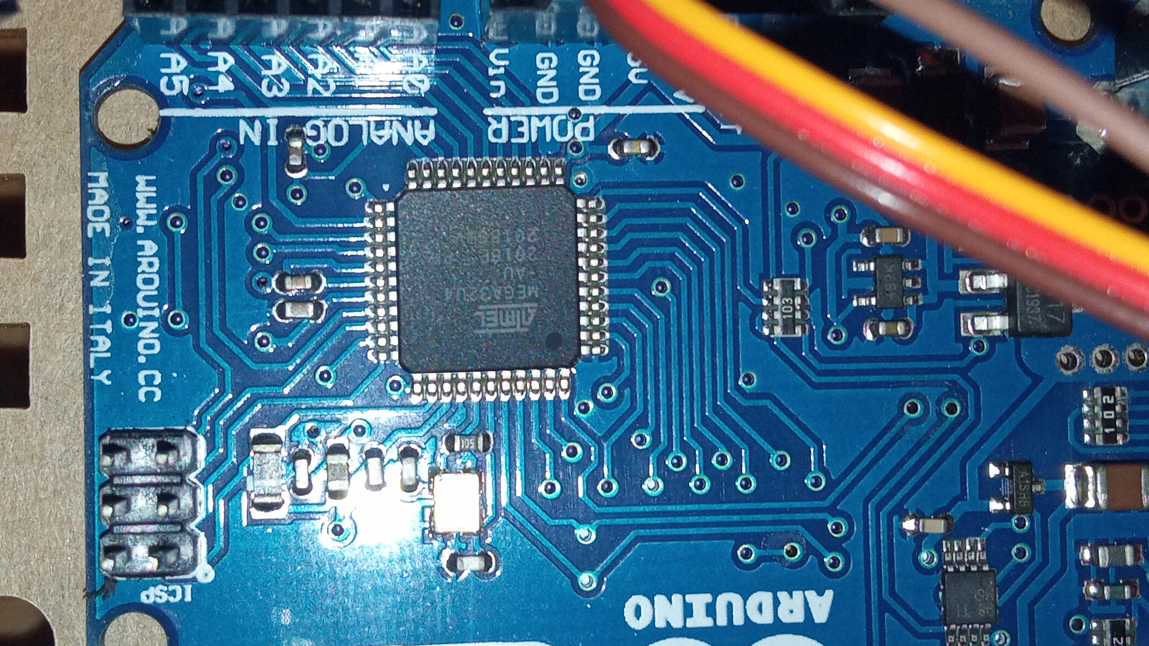
5. UNDERSTANDING
MICROCONTROLLER
DATA FORMAT AND
DIRECTIVES: A
COMPREHENSIVE
OVERVIEW
By 2003028-MD ABDULLAH AL MAMUN

Slide 28

MICROCONTROLLER DATA FORMAT
AVR data type
The AVR microcontroller has only one data type. It is 8 bits, and the size of each register is also 8 bits.
Data format representation
There are four ways to represent a byte of data in the AVR assembler. The numbers can be in hex, binary', decimal, or ASCII formats.

Slide 29

DATA FORMAT REPRESENTATION
• Hex numbers
Ox (or OX) or $ in front of the number $75 or 0x11
• Binary numbers
Only B infront of the number
0b10011001
• Decimal numbers
No special representation 75
• ASCII Characters
Only B infront of the number
'2' - 00110010 or 32 in hex.

Slide 30
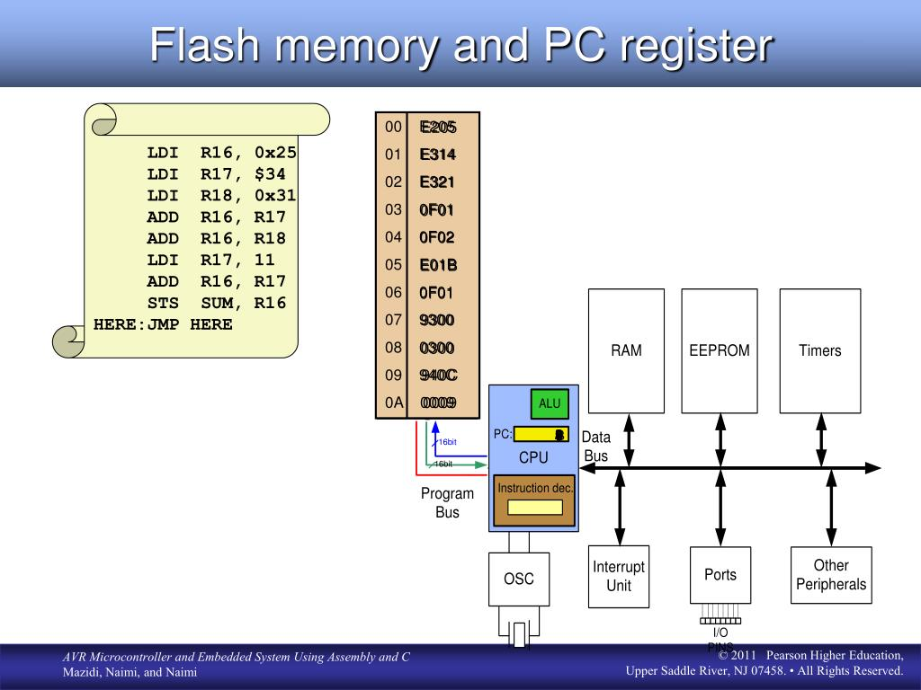
MICROCONTROLLER DIRECTIVES
Directives in AVR microcontroller programming provide instructions to the assembler
while instructions tell the CPU what to do.

Slide 31
.EQU (equate)
To define a constant value or a fixed address. .EOU COUNT = 0x25
Note: .EQU can be used for RAM address assignment and SFR address assignment
.SET
To define a constant value or a fixed address by the value may be reassigned later the .SET directive.

Slide 32
.ORG (origin)
To indicate the beginning of the address. It can be used for both code and data.
.INCLUDE directive
To add the contents of a file to our program (like the #include directive in C language).

Slide 33
6. Microcontroller Assembly
Microcontroller Assembly Programing
By 2003023-MD RASHEDUL ISLAM

Slide 34
Introduction to Assembly Programming
Binary and machine language challenges
Hexadecimal system introduction
Evolution to Assembly languages
Mnemonics for human-friendly coding
Low-level programming and CPU interaction
Role of the assembler in translation
Comparison with high-level languages
Key Message: Assembly languages bridge the gap between machine language and human-readable code.

Slide 35
Assembly Language Structure
An Assembly language instruction consists of four fields:
label: mnemonic operands ; comment
Important Points:
1. The label field allows the program to refer to a line of code by name. The label field cannot exceed a certain number of characters.
2. The comment field begins with a semicolon comment indicator ";". Comments may be at the end of a line or on a line by themselves. The assembler ignores comments, but they are indispensable to programmers.
3.The Assembly language mnemonic (instruction) and operand(s) fields togeth­er perform the real work of the program and accomplish the tasks for which the program was written.
Example: LDI R23, $55
ADD R23, Rl9
SUBI R23, $67

Slide 36
Sample of an Assembly Language Program
;AVR Assembly Language Program To Add Some Data.
;store SUM in SRAM location Ox300.
.EQU SUM Ox300 ;SRAM loc $300 for SUM
.ORG 00 ;start at address 0
LDI Rl6, 0x25 ; Rl6 0x25
LDI Rl7, $34 ; Rl7 0x34
LDI Rl8, Ob00110001 ; Rl8 0x31
ADD Rl6, Rl7 ;add Rl7 to Rl6
ADD Rl6, Rl8 ;add Rl8 to Rl6
LDI Rl7, 11 ;Rl7 = 0x0B
ADD Rl6, Rl7 ;add Rl7 to Rl6
STS SUM, Rl6 ;save the SUM in loc $300
HERE: JMP HERE ;stay here forever
Mnemonic
Comment
Operands
Label

Slide 37
ASSEMBLING AN AVR PROGRAM
Editor Program
myfile.asm
Assembler
Program
myfile.eep myfile.hex myfile.map myfile.lst myfile.obj
Download to AVR’s EEPROM
Download to
AVR’s FLASH

Slide 38
ASSEMBLING AN AVR PROGRAM
Editor Program: Used to write and modify code files; common ones include Notepad, Visual Studio Code, or Atmel Studio for AVR programming.
ASM File (Assembler Code): AVR assembly code written by the programmer, providing low-level instructions for the AVR microcontroller.
Assembler Program: Converts ASM code into machine code (binary), creating an OBJ file for AVR programs.
EEP File: Stands for Electrically Erasable Programmable Read-Only Memory; contains non-volatile data for the AVR's EEPROM, preserving data between power cycles.

Slide 39
ASSEMBLING AN AVR PROGRAM
Hex File: Compiled machine code in hexadecimal format; loaded onto AVR microcontrollers for execution.
Map File: Offers a detailed map of memory usage, showing how program elements occupy space in the AVR's memory.
LST File: Lists the assembly instructions with corresponding memory addresses, aiding in program analysis and debugging.
OBJ File: Intermediate file generated by the AVR assembler, containing relocatable machine code before being linked to create the final HEX file for AVR microcontrollers.

Slide 40
Topic 7: Program Counter and Program ROM Space in Microcontroller
Prepared by Md. Al-zami ashraf - 2003024

Slide 41
Program Counter in Microcontroller
An important internal register.
Used to point to the address of the next instruction to be executed.
As CPU fetches the opcode from the program ROM, the program counter is incremented automatically to point to the next instruction.
The wider the program counter, more the memory locations a CPU can access. For example: 16-bit program counter has in total 2¹⁶= 64K locations
Minimum address: 0000 0000 0000 0000B= 0000H
Maximum address: 1111 1111 1111 1111B= FFFFH
Each memory location can carry 2 bytes.

Slide 42
Table: Microcontroller On-chip ROM Size and Address Space
 | On-chip Code ROM (Bytes) | Code Address Range (Hex) | ROM Organization
ATtiny25 | 2K | 00000-003FF | 1K*2 bytes
ATmega8 | 8K | 00000-00FFF | 4K*2 bytes
ATmega32 | 32K | 00000-03FFF | 16K*2 bytes
ATmega64 | 64K | 00000-07FFF | 32K*2 bytes
ATmega128 | 128K | 00000-0FFFF | 64K*2 bytes
ATmega256 | 256K | 00000-1FFFF | 128K*2 bytes

Slide 43
Where the microcontroller wakes up when it is powered up
In the case of the microcontroller(that is, all members regardless of the family and variation), the microcontroller wakes up at memory address 0000 when it is powered. By powering up it is meant that V_{CC} is applied to the RESET pin.
In other words, when the microcontroller is powered up, the program counter has the value of 0000 in it. This means that it expects the first opcode to be stored at ROM address $00000. For this reason, in the microcontroller system, the first must be burned into memory location $00000 of program ROM because this is where it looks for the first instruction when it is booted.

Slide 44
Placing code in program ROM
The list file of a sample program is examined and showed how the code is placed into the Flash ROM of the AVR chip. The opcode and the operand for each instruction are listed on the left side of the list file.
After the program is burned into ROM of an
AVR family member such as ATmega32 or
ATtiny11, the opcode and operand are placed
in ROM memory locations starting at 0000.
The list shows that address 0000 contains
E205, which is the opcode for moving a value
in R16, and the operand to be moved to R16.
Therefore, the instruction “LDI R16, 0X25” has a
machine code of “E205”, where E is the opcode
and 205 is the operand.
;AVR Assembly Language Program to Add Some Data
;store SUM in SRAM location 0x300
.EQU SUM = 0X300 ;SRAM loc $300 for SUM
.ORG 00 ;start at address 0
LDI R16, 0x25 ;R16= 0x25
LDI R17, $34 ;R17= 0x34
LDI R18, 0B00110001 ;R18= 0x31
ADD R16, R17 ;add R17 to R16
ADD R16, R18 ;add R18 to R16
LDI R17, 11 ;R17= 0x0B
ADD R16, R17 ;add R17 to R16
STS SUM, R16 ;save the SUM in loc $300
HERE: JMP HERE ;stay here forever

Slide 45
LDI Rd, k 16<=d<=31, 0<=K<=255
LDI Rd, k₁k₀ | LDI R16, 0x25
LDI R17, 0x34 | LDI R18, 0x31
1 1 1 0 | k k k k | d d d d | k k k k
E k₁ | D k₀
E 2 | 0 5
Figure 1: The machine code for instruction “LDI Rd, k” in binary
E 3 | 1 4
E 3 | 2 1
Figure 2: The machine code for instruction “LDI Rd, k” in Hex
ADD Rd, Rr 0<=d<=31, 0<=r<=31
ADD R16, R17 | ADD R16, R18
0 0 0 0 | 1 1 r d | d d d d | r r r r
0 F | 0 1
0 F | 0 2
Figure 3: The machine code for instruction “ADD Rd, Rd” in binary
Figure 4: The machine code for “ADD Rd, Rr” in Hex
Similarly, the machine code “E314” is located in ROM memory location 0001 and represents the opcode and the operands of the instruction “LDI R17, $34”. In the same way, machine code “E321” is located in memory location 0002 and represents the opcode and the operand for the instruction “LDI R18, 0b00110001”. The memory location 0003 has the machine code o 0F01, which is the opcode and the operands for the instruction “ADD R16, R17”. Similarly, the machine code “0F02” is located in memory location 0004 and represents the opcode and the operands for the instruction “ADD R16, R18”.

Slide 46
The memory location 0005 has the opcode and the operand for the “LDI R17, 11” instruction.
The memory location 0006 has the opcode and the operand for the “ADD R16, R17” instruction.
The opcode for instruction “STS SUM, R16” is located at address 00007 and its address 0x300 at address 00008.
The opcode for “JMP HERE” and its target address are located in locations 00009 and 0000A.
While all the instructions in this program are 2-byte instructions, the JMP and STS instructions are 4 byte instructions.

Slide 47
Executing a program instruction by instruction
When the AVR is powered up, the program counter has 00000 and starts to fetch the first instruction from location 00000 of the program ROM. In the case of the above program the first code is E205, which is the code for moving operand 0x25 to R16. upon executing the code, the CPU places the value of 25 in R16. Now one instruction is finished. Then program counter is incremented to point 00001, which contains code E324, the machine code for the instruction “LDI R17, 0x34”.
Upon executing the machine code E314, the value 0x34 is loaded to R17. Then the program counter is incremented to 0002.
ROM location 0002 has the machine code for instruction “LDI R18, 0x32”. This instruction is executed and now program counter= 0003.
This process goes on until all the instructions up to “ADD R16, R17” are fetched and executed.
Now PC= 0007 points to the next instruction, which is “STS SUM, R16”. When the instruction is executed, the content of R16 is stored into memory location 0x300. After the execution of this instruction, PC = 0009.
Now PC = 0009 points to the next instruction, which is “JMP HERE”. After the execution of this instruction, PC = 0009. This keeps the program in an infinite loop. The fact that the program counter points at the next instruction to be executed explains why some microprocessors (notably the x86) call the program counter the instruction pointer.

Slide 48
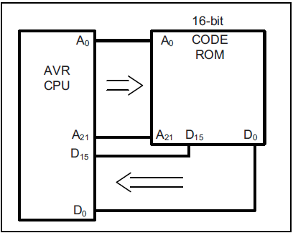
ROM width in the AVR
Each location of the address space holds two bytes (a word). If we have 16 address lines, this will give us 2¹⁶ locations, which is 64K of memory location with an address map of 0000–FFFFH. To bring in more information (code or data) into the CPU, AVR increased the width of the data bus to 16 bits. In other words, the AVR is word-addressable. In a sense, the data bus is like traffic lanes
on the highway where each lane is 8 bits wide. The more lanes, the more
information we can bring into the CPU for processing. For the AVR, the internal
data bus between the code ROM and the CPU is 16 bits wide, as shown in the
figure. Therefore, the 64K ROM space is shown as 32K × 16 using a 16-bit word
data size. The same rule applies to the entire program address space of AVR,
which is 8M, organized as 4M × 16.
Figure: Program ROM width for the AVR

Slide 49
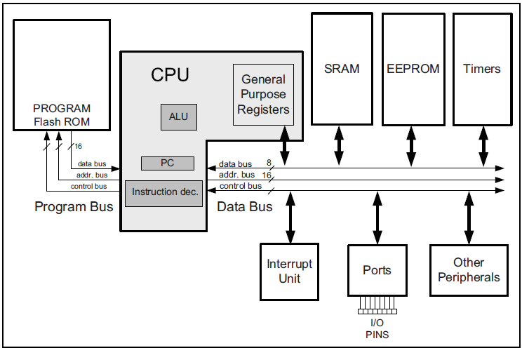
Harvard architecture in the AVR
Figure: Harvard Architecture in the AVR

Slide 50
Instruction size of the AVR
LDI instruction formation The LDI is a 2-byte (16-bit) instruction. Of the 16 bits, the first 4 bits are set aside for the opcode, the second and the fourth 4 bits are used for the value of 00 to $FF, and the third 4 bits present the destination register. This is shown below.
ADD instruction formation
The ADD is a 2-byte (16-bit) instruction. Of the 16 bits, the first 6 bits are set aside for the opcode, and the other 10 bits represent the source and the destination registers. This is shown below.
LDI Rd, K ;load register Rd with value K 16<=d<=31, 0<=K<=255
ADD Rd, Rr ;add Rd to Rr 0<=d<=31, 0<=r<=31
1 1 1 0 | K K K K | d d d d | K K K K
0 0 0 0 | 1 1 r d | d d d d | r r r r
STS instruction formation
The STS is a 4-byte (32-bit) instruction. Of the 32 bits, the first 16 bits are set aside for the opcode and the address of the source, and the other 16 bits are used for the address of the destination. This is shown below.
LDS instruction formation
The LDS is a 4-byte (32-bit) instruction. Of the 32 bits, the first 16 bits are set aside for the opcode and the destination register, and the other 16 bits are used for the address of the source memory location. This is shown below.
STS k, Rr ; store register Rr in memory location k 0<=r<=31, 0<=k<=65535
LDS Rd, k ;Load from memory location k to register Rd 0<=d<=31, 0<=k<=65535
1 0 0 1 | 0 0 1 r | r r r r | 0 0 0 0
k k k k | k k k k | k k k k | k k k k
1 0 0 1 | 0 0 0 d | d d d d | 0 0 0 0
k k k k | k k k k | k k k k | k k k k

Slide 51
Instruction size of the AVR
IN instruction formation
The IN is a 2-byte (16-bit) instruction. Of the 16 bits, the first 5 bits are set aside for the opcode, and the other 11 bits are used for the address of the source memory location, and destination register. This is shown below.
OUT instruction formation
The OUT is a 2-byte (16-bit) instruction. Of the 16 bits, the first 5 bits are set aside for the opcode, and the other 11 bits are used for the address of the source memory location and destination register. This is shown below.
IN Rd, A ;load from Address A of I/O memory into register Rd 0<=d<=31, 0<=A<=63
OUT A, Rr ;Store register Rr in I/O memory location A 0<=d<=31, 0<=A<=63
1 0 1 1 | 0 A A d | d d d d | A A A A
1 0 1 1 | 1 A A r | r r r r | A A A A
JMP instruction formation
The JMP is a 4-byte (32-bit) instruction. Of the 32 bits, only 10 bits are set aside for the opcode, and the rest (22 bits) are used for the target address of the JMP. This is shown below. The 22-bit address gives us 4M of address space; so, it can address all of the ROM space.
JMP k ;Jump to address k 0<=k<=4M
1 0 0 1 | 0 1 0 k | k k k k | 1 1 0 k
k k k k | k k k k | k k k k | k k k k

Slide 52

8. Branch instructions and looping For AVR Microcontroller Assembly
This topic discusses
Instructions used for looping
Instructions for conditional branches
Instructions unconditional branches (jumps).
By 2003030-TANJIM MOHAMMAD MUBARRAT

Slide 53
Using BRNE instruction for looping
;this program adds value 3 to the R20 ten times
.INCLUDE “M32DEF.INC”
LDI R16, 10 ;R16 = 10 (decimal) for counter
LDI R20, 0 ;R20 = 0
LDI R21, 3 ;R21 = 3
AGAIN:ADD R20, R21
;add 03 to R20 (R20 = sum)
DEC R16 ;decrement R16 (counter)
BRNE AGAIN ;repeat until COUNT = 0
OUT PORTB,R20 ;send sum to PORTB
The BRNE (branch if not equal) instruction uses the zero flag in the status register.
In each iteration, the DEC instruction decrements the R16 and sets the flag bits accordingly. If R16 is not zero (Z = 0), it jumps to the target address associated with the label “AGAIN”. This looping action continues until R16 becomes zero.

Slide 54
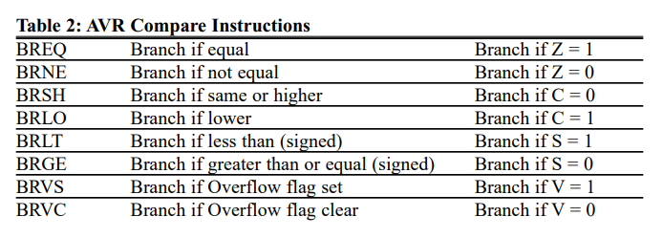
Other Conditional Jumps

Slide 55
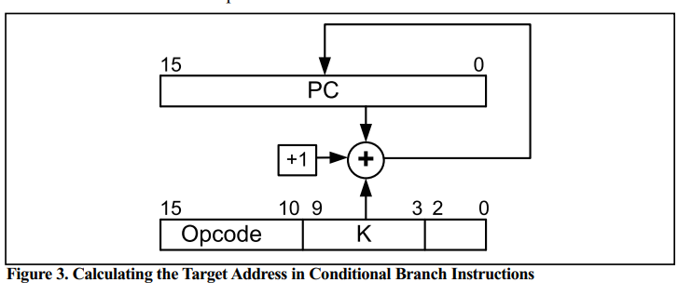
All conditional branches are short jumps
It must be noted that all conditional jumps are short jumps, meaning that the address of the target must be within 64 bytes of the program counter (PC)
Target Address = Relative Address+ PC
If the relative address is positive, the jump is forward. If the relative address is negative, then the jump is backwards.

Slide 56
Unconditional branch instructions
RJMP (relative jump)
In this 2-byte (16-bit) instruction, the first 4 bits are the opcode, and the rest(lower 12 bits) is the relative address of the target location.
IJMP (indirect jump)
IJMP is a 2-byte instruction. When the instruction executes, the PC is loaded with the contents of the Z register
JMP (JMP is a long jump)
JMP is an unconditional jump that can go to any memory location in the 4M (word) address space of the AVR. It is a 4-byte (32-bit) instruction in which 10 bits are used for the opcode, and the other 22 bits represent the 22-bit address of the target location.

Slide 57
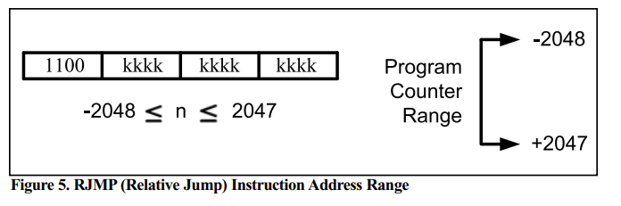
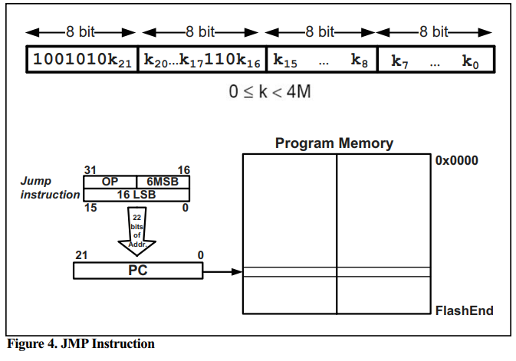
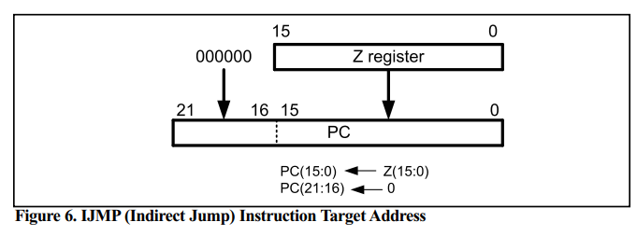
Figurative Explanation

Slide 58
Microcontroller Assembly
9. Call Instructions and stack
By 2003022-ΑΝΙΚΑ MAHBUBA

Slide 59
Call Instruction
Used to call a subroutine (A group of instructions need to be called
frequently)
In AVR, the instructions to call subroutine is as below:
CALL- long call
RCALL- Relative call
ICALL- Indirect call to Z
EICALL- Subroutine Return

Slide 60
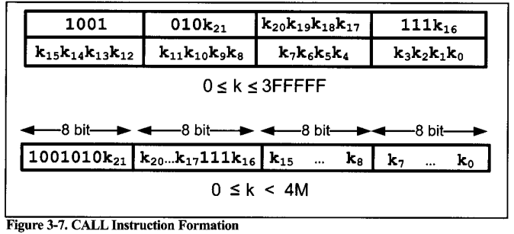
It is used to call subroutine
located anywhere within the
4M address space of 000000
to 3FFFFF
For Atmega 32 it is from
0000 to 3FFF

Slide 61
Stack
The stack operates on the Last In, First Out (LIFO))
The stack is a section of RAM used by the CPU to store information temporarily.
Information could be data or address.
Because there are only a limited number of registers we need to use portion of a RAM for storing extra data or address.

Slide 62
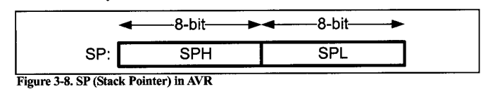
Stack Pointer in AVR
In I/O memory space, there are two registers:
1.SPL(the low byte of the SP)
2.SPH(the high byte of the SP)

Slide 63
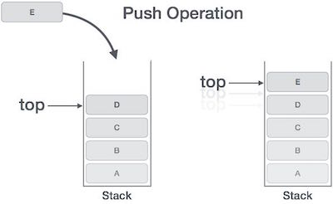
Pushing onto stack
The storing of CPU information
such as the program counter on
the stack is called a PUSH
To push a register onto the stack we
use the PUSH instruction:
This Photo by Unknown Author is licensed under CC BY-SA
PUSH R10 ;store r10 onto stack and decrement SP

Slide 64
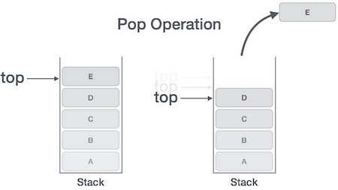
Popping from the stack
The loading of stack contents back
into a CPU register is called a POP
To retrieve a byte of a data back from
a stack we use the POP instruction:
This Photo by Unknown Author is licensed under CC BY-SA
POP R16 ;increment SP and then load the top of stack to R10

Slide 65
Initializing The Stack Pointer
To initialize the SP, load
The high byte of RAMEND into SPH and
The low byte of RAMEND into SPL.
; AVR Assembly Code to Initialize Stack Pointer LDI R16, HIGH(RAMEND) ; Load high byte of RAMEND into register R16 OUT SPH, R16 ; Set SPH to the high byte of RAMEND LDI R16, LOW(RAMEND) ; Load low byte of RAMEND into register R16 OUT SPL, R16 ; Set SPL to the low byte of RAMEND

Slide 66
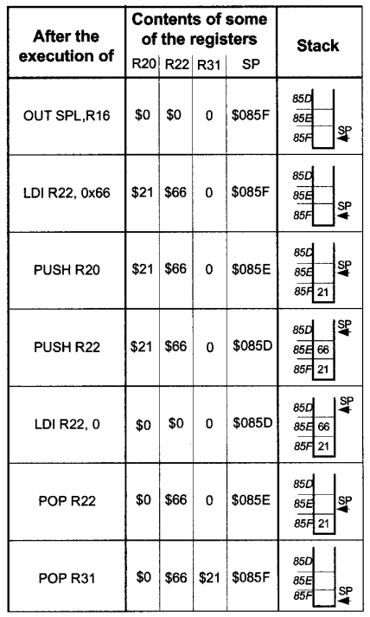
Example:
. INCLUDE "M32DEF. INC"
.ORG 0
LDI R16, HIGH (RAMEND)
OUT SPH, R16
LDI R16, LOW (RAMEND)
OUT SPL, R16
LDI R31,0
LDI R20, 0x21
LDI R22, 0x66
PUSH R20
PUSH R22
LDI R20,0
LDI R22,0
POP R22
POP R31

Slide 67
CALL & RET Instruction
1. CALL Instruction
Usage: Initiates a subroutine call, transferring
control to a specified subroutine.
Format: CALL Target_Subroutine_Address
Effect on Stack:
Pushes the return address onto the stack.
Updates the Stack Pointer (SP).
2. RET Instruction
Usage: Returns from a subroutine, resuming
execution from the saved return address.
Format: RET
Effect on Stack:
Pops the return address from the stack.
Updates the Stack Pointer (SP).
; Example Subroutine Call and Return Main: CALL MySubroutine ; Call subroutine ; Continue with the main program ... MySubroutine: ; Subroutine code here ... RET ; Return from subroutine

Slide 68
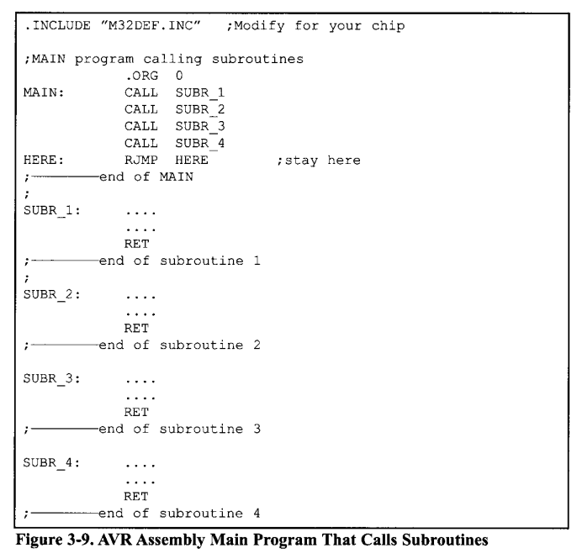
Calling many
subroutines
from the main
program

Slide 69
RCALL Instruction
RCALL is a 2-byte instruction.
Main: RCALL Near_Subroutine ; Relative call to a nearby subroutine ; Continue with the main program ... Near_Subroutine: ; Subroutine code here ... RET ; Return from subroutine
Uses 12 bits for the address
within the 2-byte instruction.
Target address range: -2048 to
+2047 words relative.
The target address for CALL can be anywhere within 4M address space of
the AVR whileThe target address of RCALL must be within a 4k range.

Slide 70
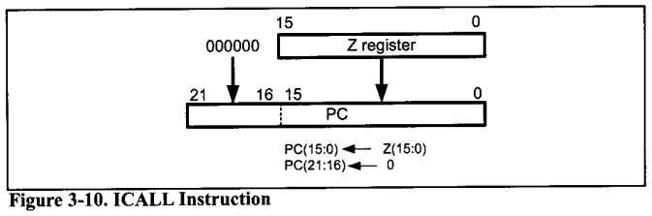
ICALL Instruction
Indirect call of a subroutine
pointed to by the Z pointer
(16bit) register .
Main: ; Load target address into Z register ldi ZH, high(Target_Subroutine) ldi ZL, low(Target_Subroutine) ; Indirect call using ICALL ICALL ; Continue with the main program ... Target_Subroutine: ; Subroutine code here ... RET ; Return from subroutine
‘ICALL’ doesn’t automatically
manage the stack for return
addresses.

Slide 71
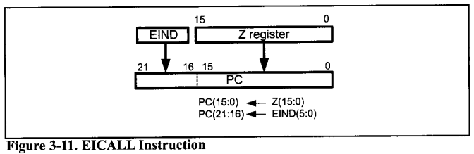
EICALL Instruction
Extended Indirect CALL
In the AVRs with more than
64k words of program memory,
the EICALL instruction is available.
The EICALL loads the Z register
into the lower 16 bits of the pc and
the EIND register into the upper 6
bits of the pc.

Slide 72
10. AVR time delay and Instruction pipeline
AVR multistage execution pipeline
Instruction cycle time for the AVR
Branch penalty
Delay calculation for the AVR
By Tonmoy-2003027

Slide 73
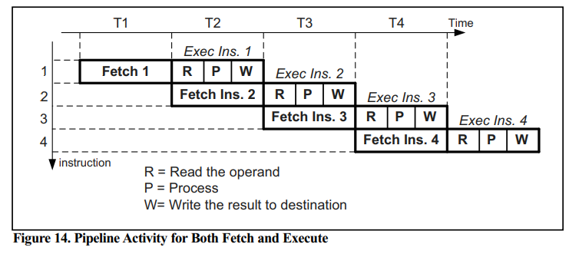
AVR multistage execution pipeline
In the AVR, each instruction is executed in 3 stages:
Operand fetch (R)
ALU operation execution (P)
Result write back. (W)

Slide 74
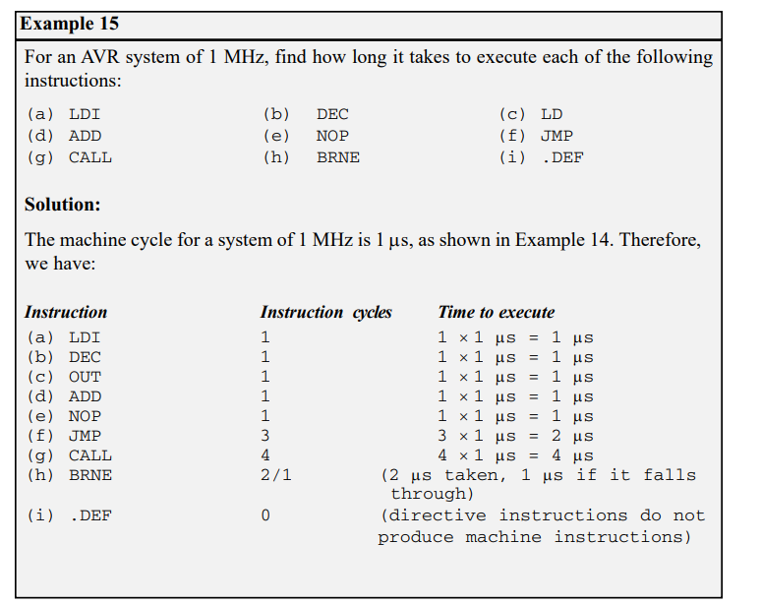
Instruction cycle time for the AVR
To calculate the machine cycle for the AVR, we take the inverse of the crystal frequency

Slide 75
Branch penalty
When a branch instruction is executed, the CPU starts to fetch codes from the new memory location, and the code in the queue that was fetched previously is discarded. In this case, the execution unit must wait until the fetch unit fetches the new instruction. This is called a branch penalty
This means that while the vast majority of AVR instructions take only one machine cycle, some instructions take two, three, or four machine cycles. These are JMP, CALL, RET, and all the conditional branch instructions such as BRNE, BRLO, and so on.

Slide 76
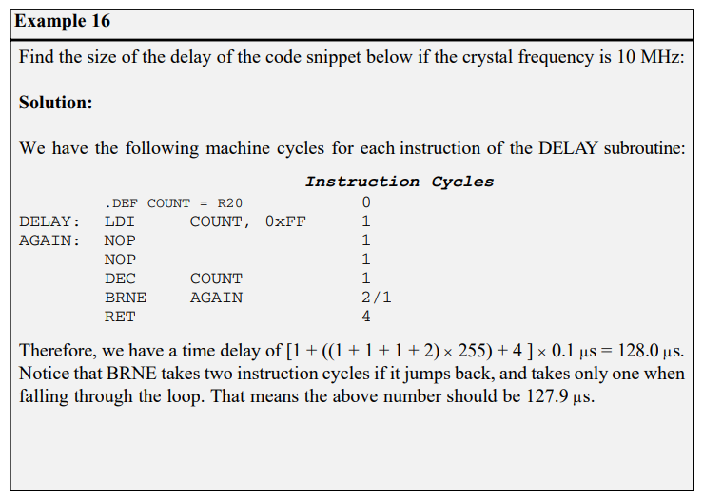
Delay calculation for the AVR
Two factors that can affect the accuracy of the delay:
The crystal frequency
The AVR design

Slide 77

Arithmetic instructions of AVR
Addition
Subtraction
Multiplication
Division
For Both Signed and Unsigned Numbers

Slide 78

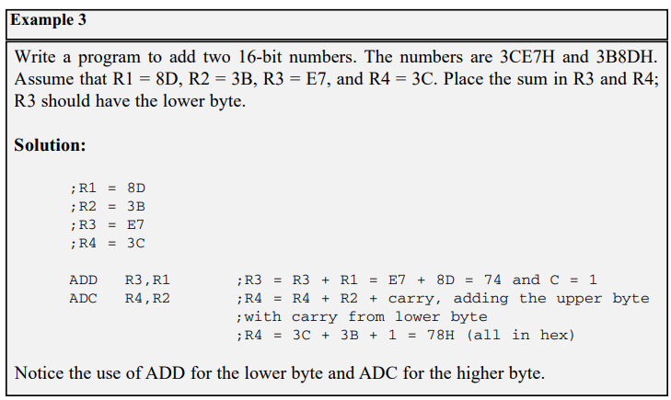
Addition of numbers
When adding two 16-bit data operands, we need to be concerned with the propagation of a carry from the lower byte to the higher byte. This is called multibyte addition to distinguish it from the addition of individual bytes. The instruction ADC (ADD with carry) is used on such occasions.
The instruction adds Rr (resource) to Rd (destination) and stores the result in Rd. It could change any of the Z, C, N, V, H or S bits of the status register, depending on the operands involved

Slide 79
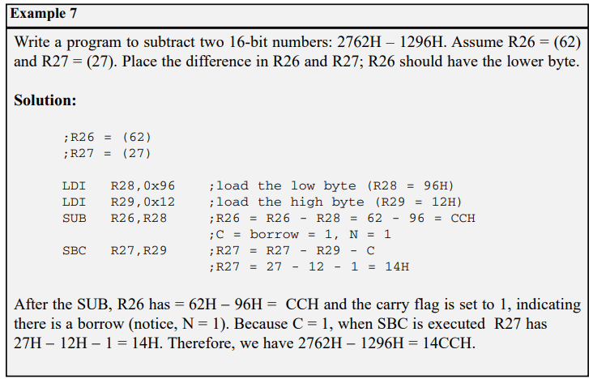
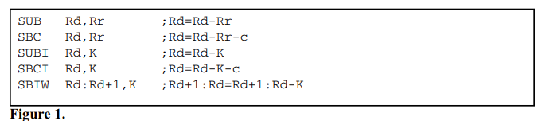
Subtraction of numbers
In the AVR we have five instructions for subtraction: SUB, SBC, SUBI, SBCI, and SBIW

Slide 80
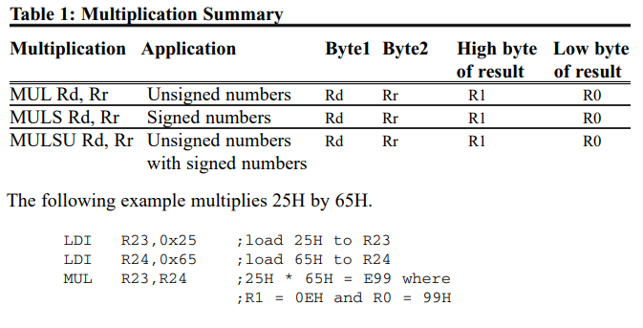
Multiplication of numbers
MUL is a byte-by-byte multiply instruction. In byte-by-byte multiplication, operands must be in registers. After multiplication, the 16-bit unsigned product is placed in R1 (high byte) and R0 (low byte).

Slide 81
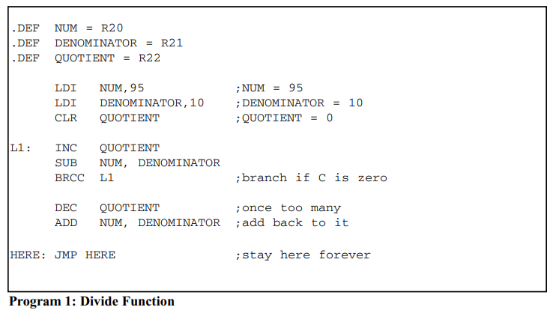
Division of unsigned numbers
AVR has no instruction for divide operation. We can write a program to perform division by repeated subtraction. In dividing a byte by a byte, the numerator is placed in a register and the denominator is subtracted from it repeatedly. The quotient is the number of times we subtracted, and the remainder is in the reg

Slide 82
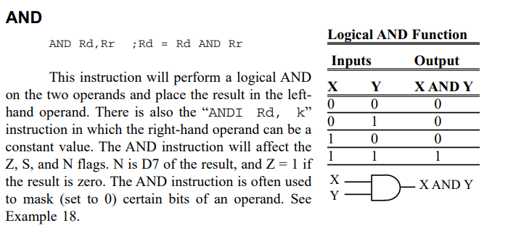
LOGIC AND COMPARE INSTRUCTIONS
Apart from I/O and arithmetic instructions, logic instructions are some of the most widely used instructions. In this section we cover Boolean logic instructions such as AND, OR, Exclusive-OR (XOR), and complement. We will also study the compare instruction

Slide 83
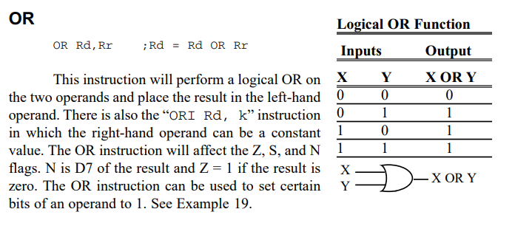
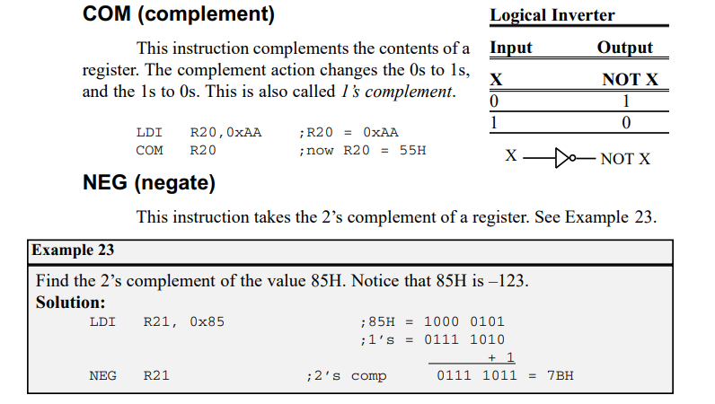
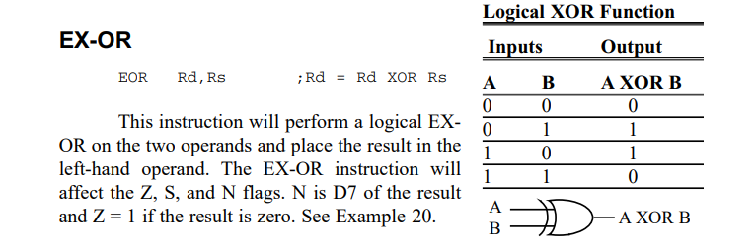
LOGIC AND COMPARE INSTRUCTIONS

Slide 84
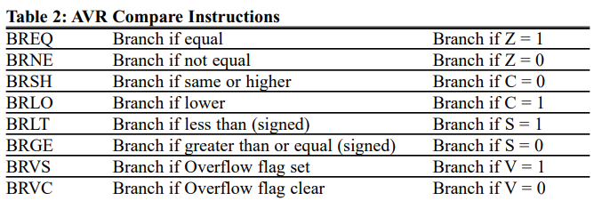
Compare instructions
The AVR has the CP instruction for the compare operation. The compare instruction is really a subtraction, except that the values of the operands do not change. There is also the “CPI Rd, k” instruction in which the right-hand operand can be a constant value.

Slide 85
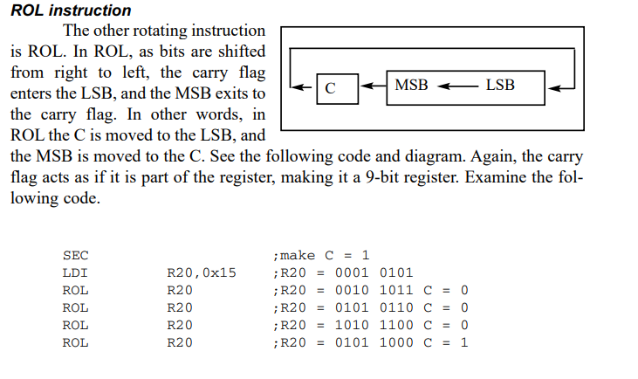
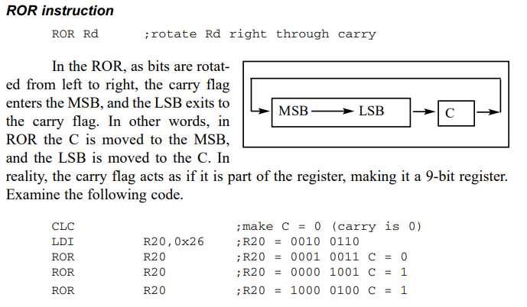
ROTATE AND SHIFT INSTRUCTIONS AND DATA SERIALIZATION
There are two ROTATE instructions in the AVR. They involve the carry flag. Each is shown next

Slide 86
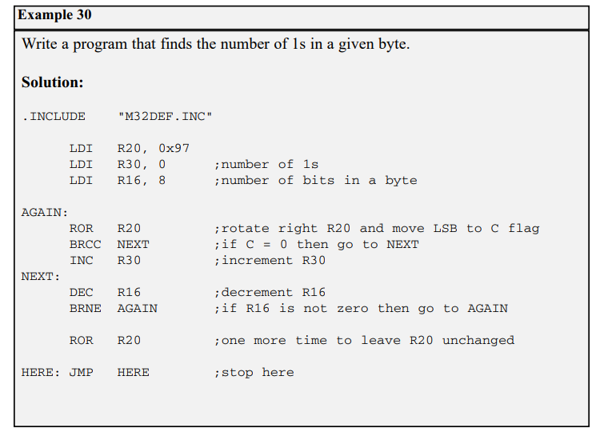
Serializing data
Using the serial port
transfer data one bit at a time and control the sequence of data and spaces between them

Slide 87
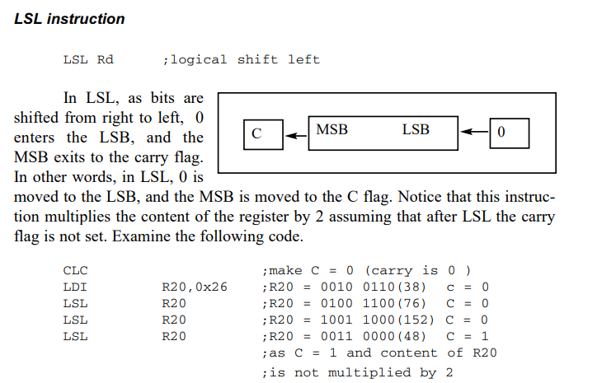
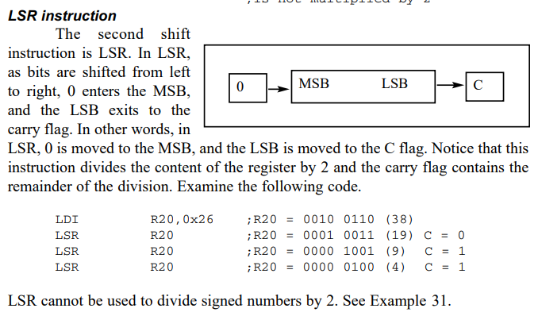
Shift instructions
There are three shift instructions in the AVR. All of them involve the carry flag. Each is shown next.

Slide 88
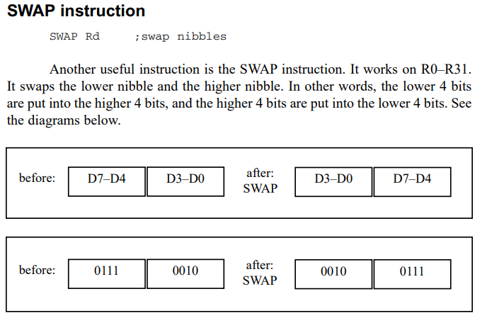
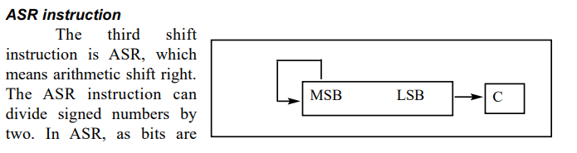
Swap and ASR instruction

Slide 89

Thank You

